Slide 1

SPARKLE
Share Your Experience!

Slide 2
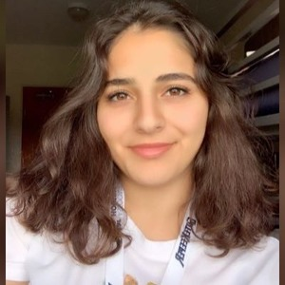
THIS IS OUR TEAM
Beyda Soyseven
Trakya University
CE & Math
Frontend
Eda Fırat
Medipol University
CE & IE
Marketing
Kevser Kendir
Maltepe University
CE & IE
Business Development
M. Arif Bağcı
Trakya University
CE & Math
Backend
Oğuz Uğurdoğan
Trakya University
Computer Engineering
Backend

Slide 3


EMMA
LUCAS
-22 Years Old.
- CE Student
-31 Years Old.
- IT Manger

Slide 4
Emma’s Needs, Expectations, and Pain Points
Destination: Going from Beşiktaş to Levent everyweek days.
High car price
Sensitive about sustainability
Anxious about public transportation because of pandemic
Wants to meet with new friends
Gain new experiences

Slide 5
Lukas’s Needs, Expectations,and Pain Points
Earning extra income
Meet with new friends
Sharing his experience about EV
Going to Maslak from Beşiktaş
He wants to earn extra money from his ride.
Wants to contribute to sustainability.

Slide 6

Our Purpose
Benefit For Users;
Less costly than owning/driving a car
No need to find pay for parking
Ability to multitask ( e.g. text/check email/watch a video)
Aweraness of electrical and hybrid cars
Value Proposotion;
Contribute to Sustainability
Decreasing CO2 Emission

Slide 7
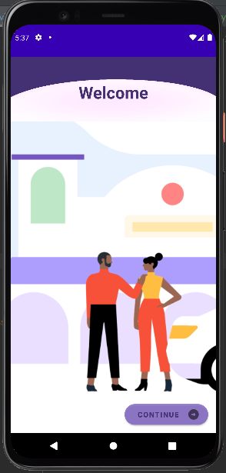
Our Product
-Register
-View Profile
-Upload Car’s Information
-View Car’s Avaliablity

Slide 8
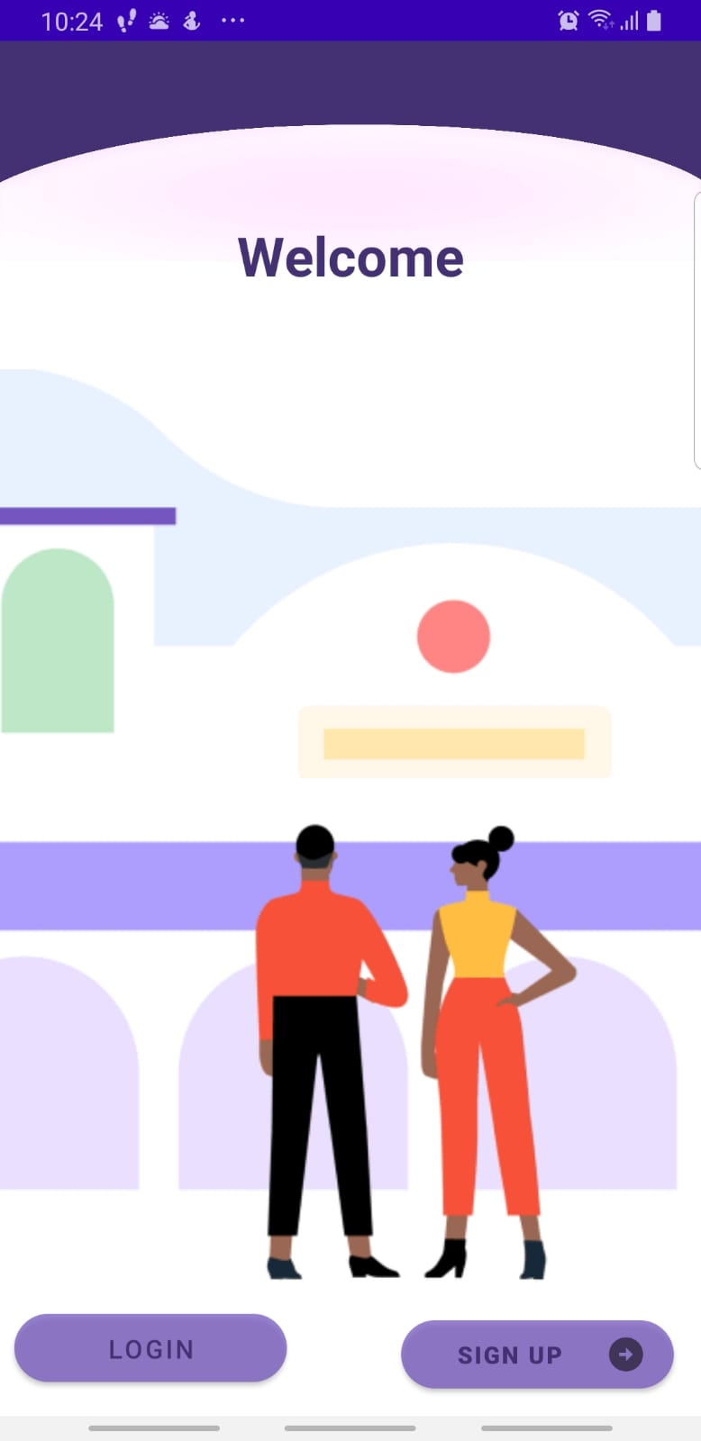
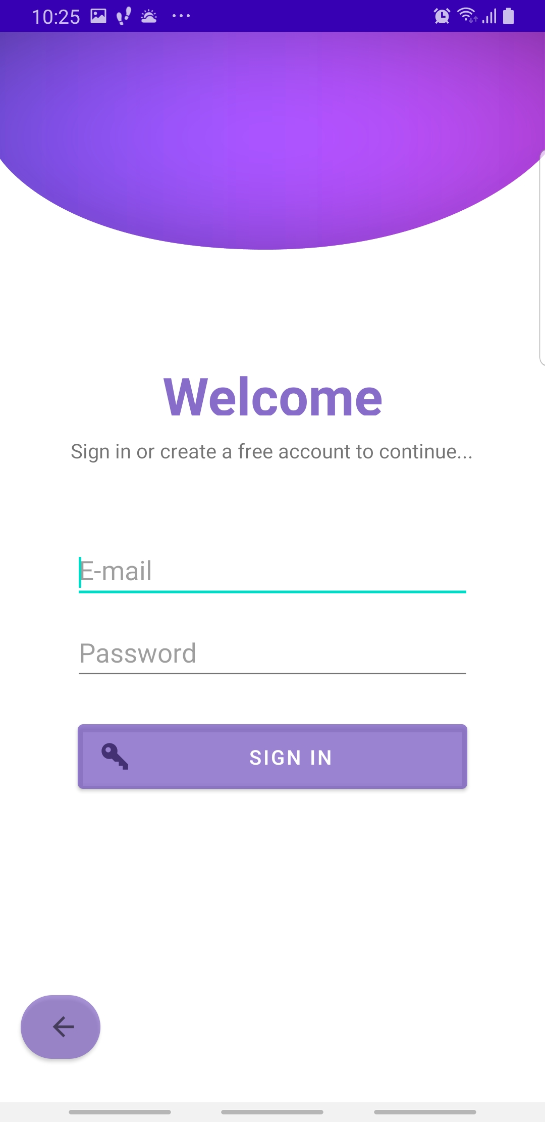
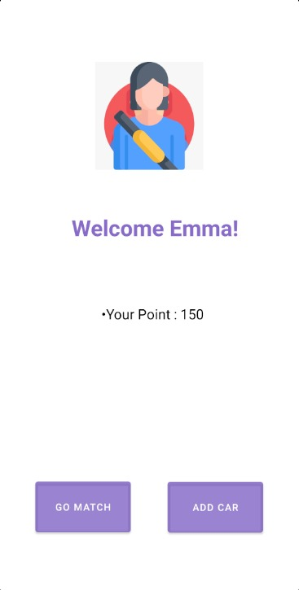
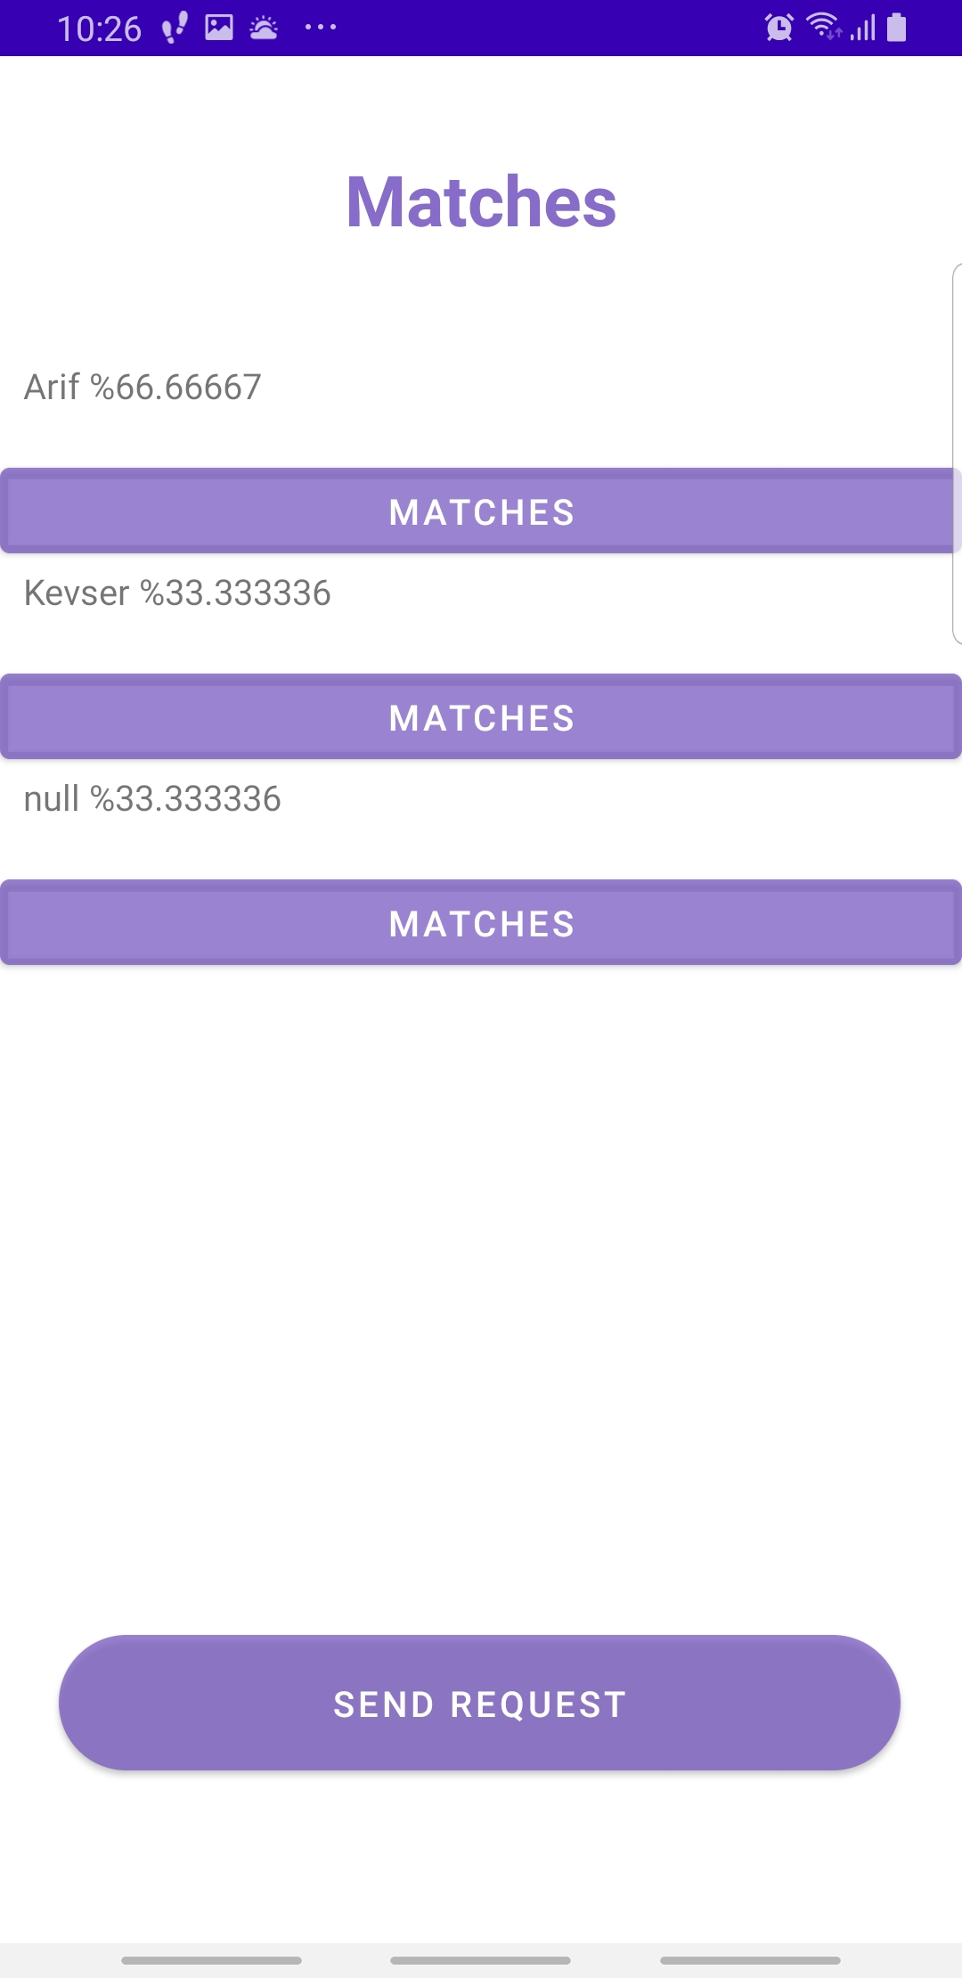
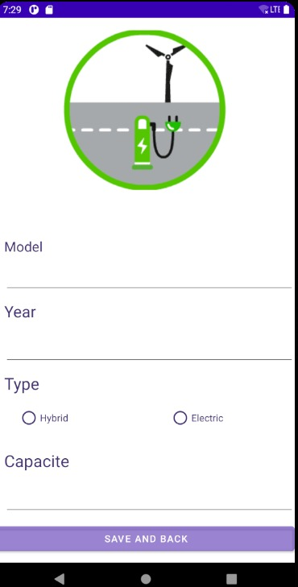

Slide 9

U !
THANK
Y

